Slide 1

EXCEL AUTOMATION USING
BLUE PRISM
Project Supervisor: Dr.L.K.Joshila grace
Name of the Student: Abishek.R
Register Number:39110013

Slide 2
Presentation Outline
Course Certificate
Introduction
Objectives
System Architecture / Ideation Map
Module Implementation
Application Snapshots
Results and Discussions
Conclusion & Future work
References

Slide 3
Course Certificate
Attach your Course Certificate here

Slide 4
Introduction
Gain insights into building blocks of blue prism automation.
Importing MS Excel VBO (Visual Basic for Applications) in Blue Prism.
Importing Excel VBO (Visual Basic for Applications) in Blue Prism.
Tuning Process Studio with specific needs.
Working with different stages in the Process studio.
Building a bot to automatically send with attachments to a list of people

Slide 5
Objectives
Blue Prism is an RPA Tool which holds the capability of virtual workforce powered by software robots.
This helps the enterprises to automate the business operations in an agile and cost-effective manner.
The tool is based on HtmlProgramming Language and offers a visual designer with drag and drop functionalities.

Slide 6
SCOPE OF RPA(Robotic process automation):
RPA has provided an excellent solution for organizations to replace repetitive, mundane, rule-based processes with software bots.
It is now helping organizations who were looking to increase their workflow accuracy and efficiency. First, RPA was widely adopted in the IT sector.

Slide 7
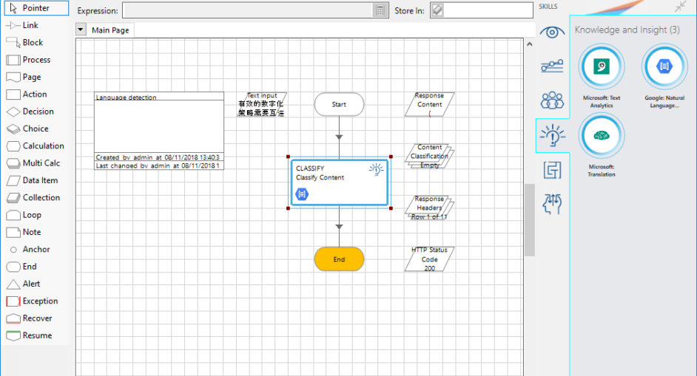
System Architecture / Ideation Map

Slide 8
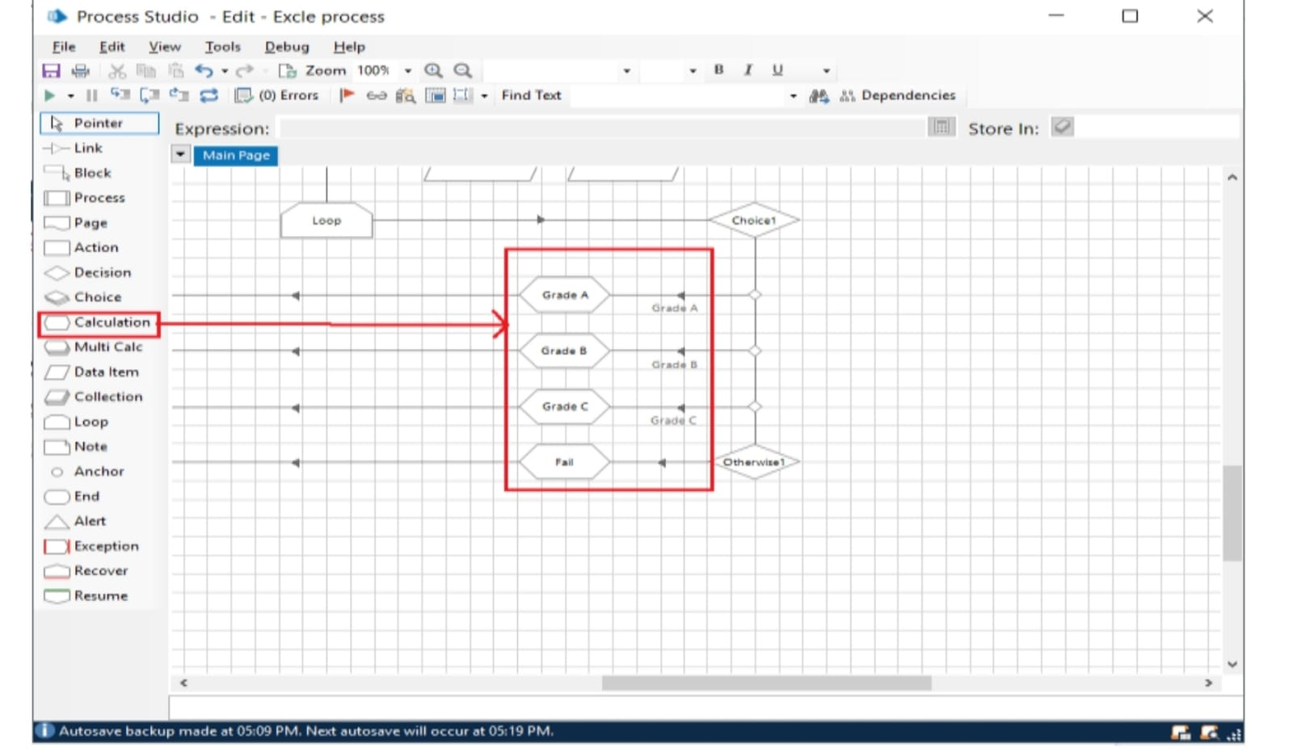
Identifiation Map

Slide 9
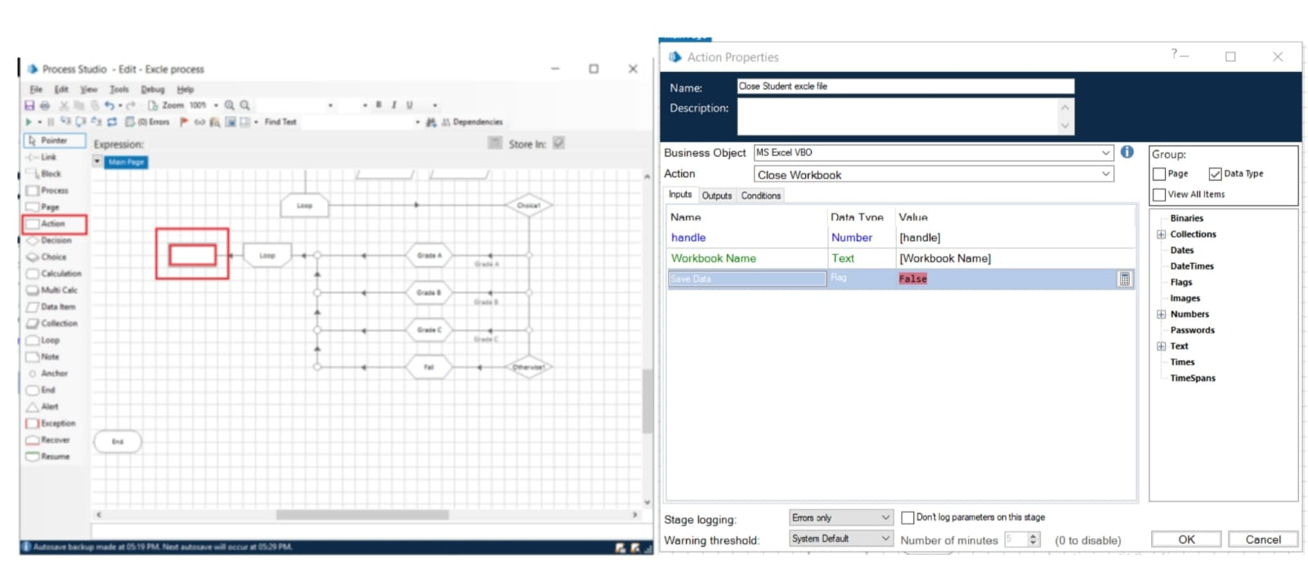
Identification Map

Slide 10
Module implementation
1. Create Action Stage as “Create Instance” (Business Object = MS Excel VBO; Action = Create Instance).
a. Click on the Outputs tab
i. Create Data Item, type = number, name = “handle”. Drag it into the Store In column.
ii. Click on ok
2. Create Action Stage as “Open Excel file” (Business Object = MS Excel VBO; Action = Open WorkBook). a. Click on the Inputs tab i. Drag “handle” data item into handle Valuecolumn. ii. Set file path of excel file in File Name Value column

Slide 11
Module implementation
b. Click on the Outputs tab i. Create Data Item, type = Text, name = “WorkBook Name”. Drag it into the Store In column. Click on OK.
3. Create Action as “Get to collection” (Business Object = MS Excel VBO; Action = Get WorkBook As Collection).
a. Click on the Inputs tab
i. Drag “handle” data item into handle Value column.
ii. Drage “Workbook Name” data item into the Workbook Name Value column.
iii. Write Worksheet Name name as “Sheet1”.

Slide 12
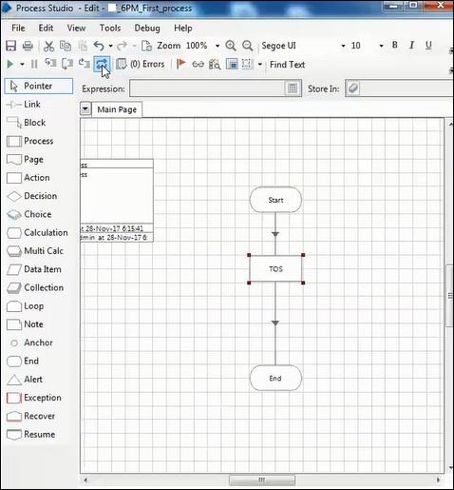
Diagram

Slide 13
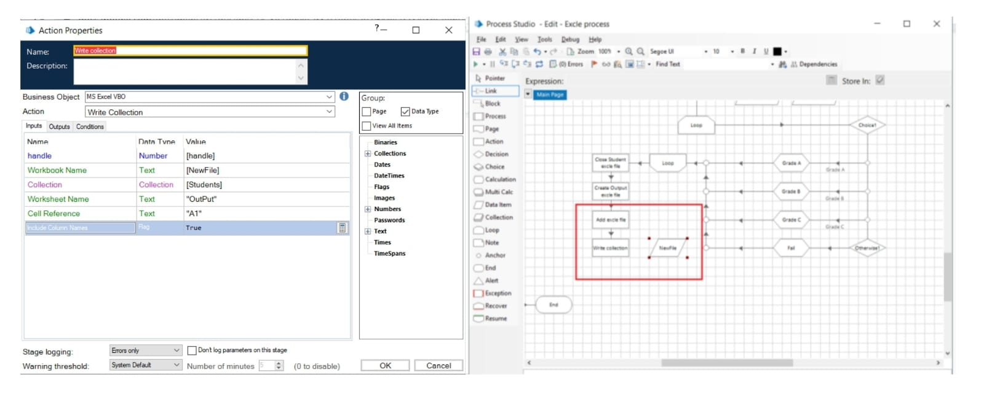
Diagram

Slide 14
Project Implementation
First design your project either by Simulation
By the end of this project you will:
.Importing MS Excel VBO(Visual Basic for Applications) in Blue Prism.
Tuning Process Studio with specific needs.
Working with different stages in the Process studio
Importing Blue Prism MS Excel VBO (Visual Basic for Applications)
Binding Process Studio with MS Excel VBO.
Opening MS Excel WorkBook.

Slide 15
Methodology
Method of approach should be presented clearly with its outline and justification. Blue Prism is deployed using a grid based virtualised runtime and control methodology, where lightweight Blue Prism resources are interconnected within the data centre through a series of Blue Prism server components to a back end database.
? Internet connection to download and activate
? Administration access to install and run Blue Prism
? Minimum 10GB free disk space
? Windows 8.1 or 10 (64-bit version only) OR Cloud: Get started free, *Cloud account required.
Your methodology should also describe your objective and how you are going to achieve your objective.

Slide 16
Methodology
500 megahertz (MHz)
256 megabytes (MB) RAM
1.5 gigabytes (GB) available space
1024x768 or higher resolution monitor
We test our software against multiple operating systems and configurations to ensure compatibility with the currently available versions. We evaluate our software against the versions listed in the tables below and highlight the most appropriate selections as recommended versions
Coding using RPA API and other API tools
Native actions for Excel automation
Object-based automation

Slide 17
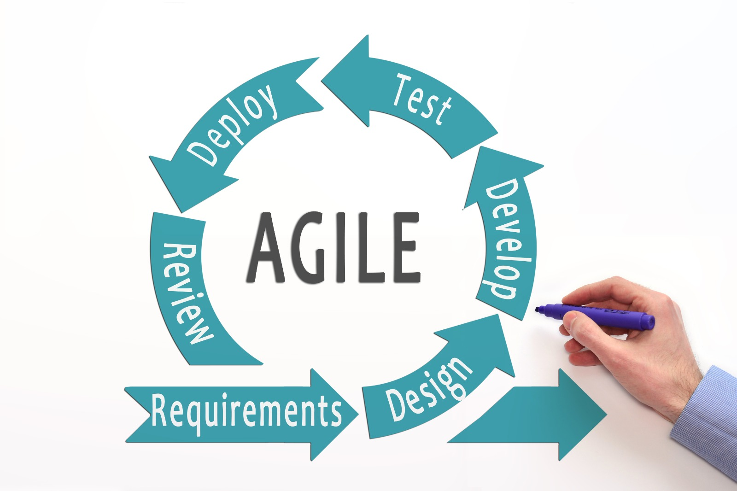
Methodology

Slide 18
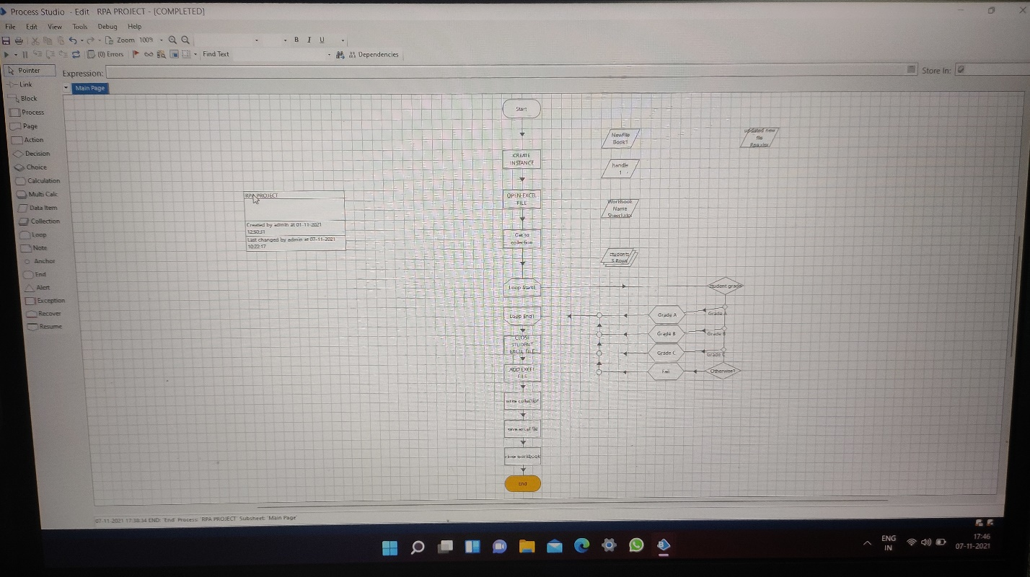
Results and Discussion
Flow chart

Slide 19
Discussion
1. Create Action Stage as “Close Student excel file (Business Object = MS Excel VBO; Action = Close WorkBook).
a. Click on the Inputs tab
i. Drag “handle” data item into handle Value column.
ii. Drag “Workbook Name” data item into the Workbook Name Value column.
iii. Save Data as “False”.
Create Action as “Create Output excel file” (Business Object = MS Excel VBO; Action = Create WorkBook).
a. Click on the Inputs tab.
i. Drag “handle” data item into handle Value column.
b. Click on the Outputs tab
i. Create Data Item, type = Text, name =”NewFile''.
ii. Drag it into the Workbook Name Store In column. Click on ok.

Slide 20
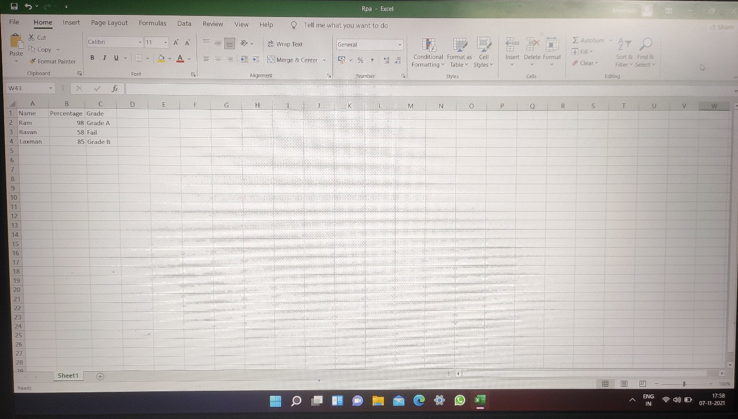
Output
All the flows was executed successfully by reading the given excel sheet and the output was stored new excel document as output.

Slide 21
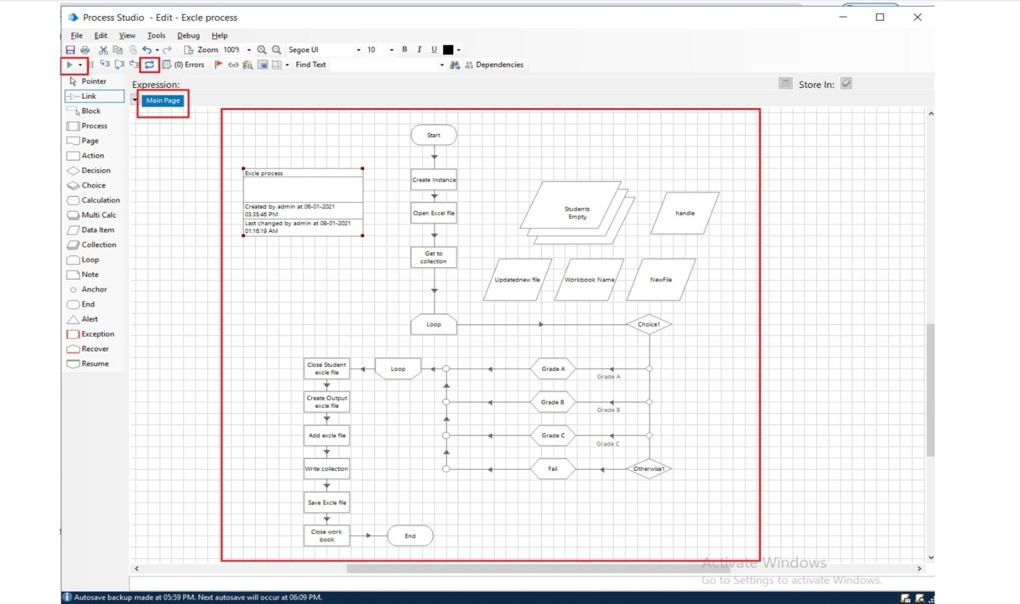
Output

Slide 22
Conclusion
The analytical process started from data cleaning and processing, missing value, exploratory analysis and finally model building and evaluation.
It has become easy to find out relation and patterns among various data’s.
Object Studio is designed to help you create small modular units for interacting with end-user applications.
Object Studio opens this opportunity up to the business user, as well as the technical expert

Slide 23
Conclusion
Conclusion Statement of the Project
From this project I get to know that Email automation very important for any other developments also. At first we have to store the each person email id in Microsoft Excel and save it for further use. We have to import MS-EXCEL VBO and Email SMTP-POP3 VOB into the Blue Prism, and then create the process and then we have to give the following actions such as create instance, opening excel file, getting email id's, closing the excel file,Configuring Email,fetching the attachments and then sending the mails. Click on refresh button then click run button to run the program. The resultant output will be emails sent with the attachment
Future Scope:
In future there will be many development takes place under this email automation.Email marketing can be further develop by this technique.this email is the top tool used by 90 % of the population.

Slide 24
Software required
Requirements:
We need to launch blue prism software is one of the technology of RPA.We need to have
MS EXCEL SHEET
PC WITH 64 BIT
DESIGN:
We need to import MS-EXCEL VBO and EMAIL SMTP Tuning process studio with specific need to build a bot. That automatically send messages
DEVELOP:
In this stage we need to develop the process studio with different stages that are required
○ Create Instance
○ Open Excel file
○ Getting email IDs
○ Closing Excel file
○ Configuring Email
○ Fetching attachments
○ Sending mails

Slide 25
Software Requirement
SOFTWARE REQUIREMENTS:
The following are the softwares required for the project:
Blue Prism software
Microsoft Excel 2013

Slide 26
Hardware Requirement
The following are the Hardware Requirements of the project
Internet connection to download and activate
Administration access to install and run Blue Prism
Minimum 10GB free disk space
Windows 8.1 or 10 (64-bit version only) OR Cloud: Get started free, *Cloud account required. Minimum System Requirements To run Office Excel 2013, your computer needs meet.
The following minimum hardware requirements:
500 megahertz (MHz)
256 megabytes (MB) RAM
1.5 gigabytes (GB) available space
1024x768 or higher resolution monitor

Slide 27
Reference
M. Lacity, L. P. Willcocks, & A. Craig.Robotic process automation at Telefonica O2.The Outsourcing Unit Working Research Paper Series, 2015
IRPA, “Introduction To Robotic Process Automation,” tech. rep., 2015.
H. P. Fung "Criteria, use cases and effects of information technology process automation (ITPA)." Advances in Robotics & Automation 3 (2014).
Dana Nau, Malik Ghallab, and Paolo Traverso Automated Planning: Theory & Practice. Morgan Kaufmann, 2014.
M. Barrett, E. Oborn, W. J. Orlikowski, and J. Yates, “Reconfiguring 4Relations: Robotic Innovations in Pharmacy Work ,” Organ. Sci., vol. 23, pp. 1448– 1466, 2012.

